Slide 1
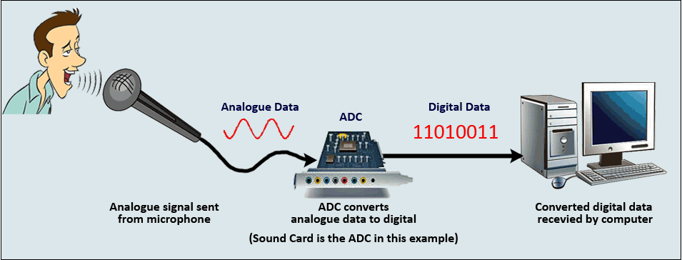
IMPORTANCE OF ANALOG TO DIGTIAL CONVERSION

Slide 2
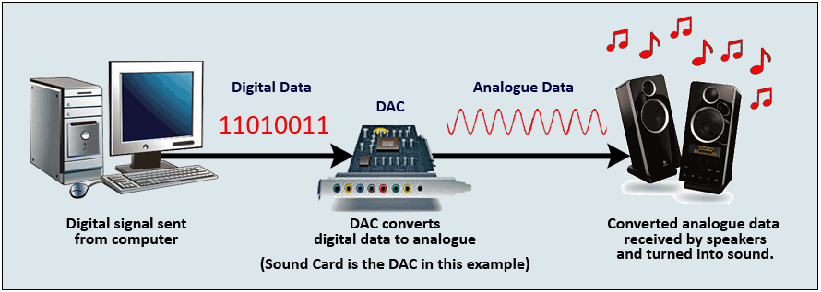
IMPORTANCE OF DIGITAL TO ANALOG CONVERSION

Slide 3
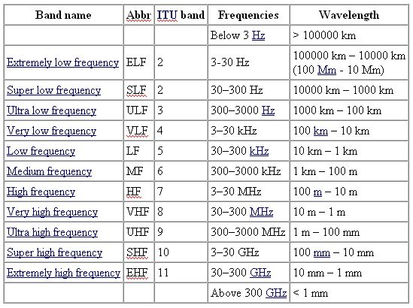

Slide 4
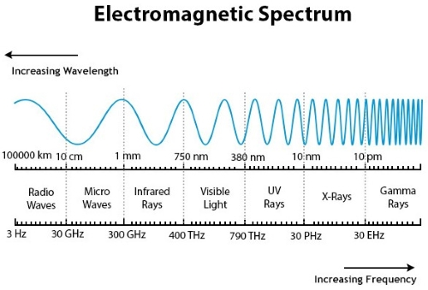

Slide 5
Baseband Signal:
A baseband signal or lowpass signal is a signal that can include frequencies that are very near zero, by comparison with its highest frequency
Baseband is a digital signal transmitted on the medium using one of the signal codes like NRZ, RZ Manchester biphase-M code, etc. called baseband transmission.
Baseband transmission:
Digital signaling.
Baseband is the bi-directional transmission.
A short-distance signal traveling.
The entire bandwidth is for single signal transmission.
Example: Ethernet is using Basebands for LAN.

Slide 6
Modulation:
We live in a digitally advanced era where the need for wires is no longer a necessity to be connected to everyone. Messages, information and signals are sent from one part of the world to another within minutes. The modulation process plays a major role in the fast transmission of signals.
Interference
Antenna Height

Slide 7
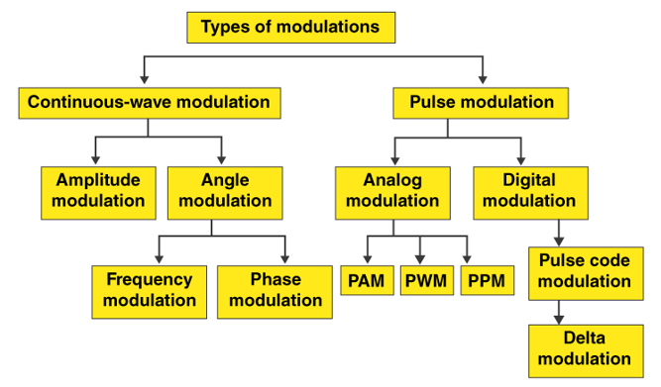

Slide 8
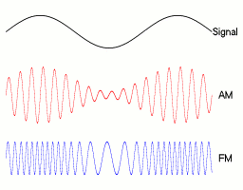
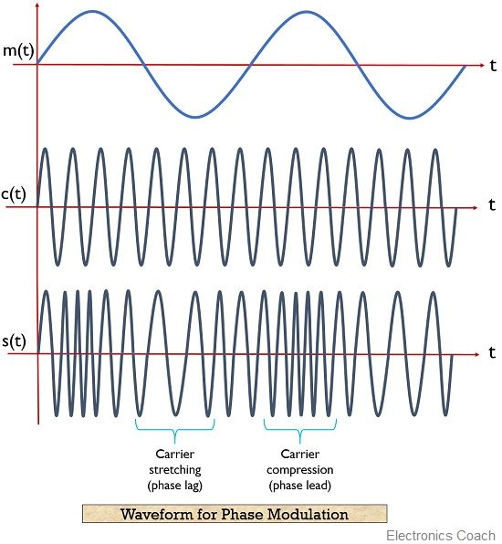
Modulation Types:
Continuous Wave:
The modulation is performed with continuous wave of carrier signal is called continuous wave modulation
Amplitude Modulation (AM)
Frequency Modulation (FM)
Phase Modulation (PM)

Slide 9
Pulse wave Modulation:
The modulation is performed with Pulse wave of carrier signal is called Pulse wave modulation
Pulse Analog Modulation:
Pulse Amplitude Modulation (PAM)
Pulse Width Modulation (PWM)
Pulse Position Modulation (PPM)

Slide 10
Pulse Digital Modulation:

Slide 11
Pulse Analog Modulations

Slide 12
Pulse Amplitude Modulation (PAM):

Slide 13
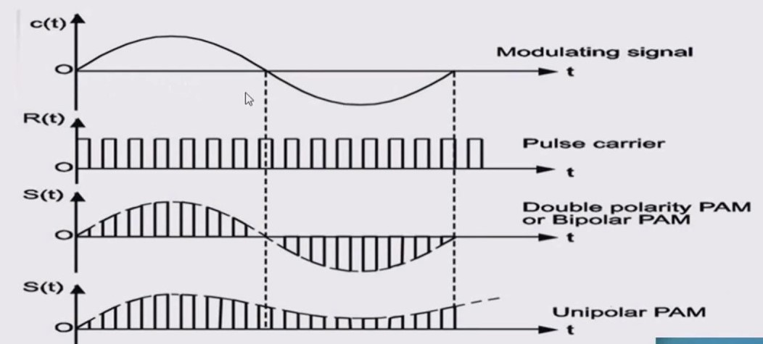

Slide 14
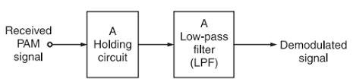
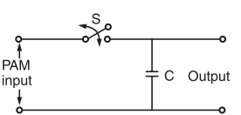
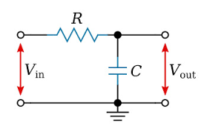
Pulse Amplitude Demodulation:

Slide 15
Advantages of Pulse Amplitude Modulation:
PAM is inexpensive and simple to integrate into a variety of systems because it only requires simple analog circuitry.
It facilitates the transfer of analog information via digital communication channels without compromising quality by encoding analog signals with discrete amplitude levels.
PAM transmits analog signals over digital communication networks with ease, making it compatible with contemporary digital communication protocols. This is made possible by its integration with digital systems.
PAM is simple, it has strong noise immunity and can withstand noise interference both during signal transmission and reception.
Simple signal processing methods like filtering and demodulation are made possible by PAM, which makes it possible to efficiently extract information from modulated signals for a variety of applications, such as audio transmission and telecommunications.

Slide 16
Disadvantages of Pulse Amplitude Modulation:
PAM is susceptible to amplitude changes, which can reduce signal quality and causes information loss during transmission, particularly when noise or channel distortion is present.
Compared to other modulation techniques, PAM demands a large bandwidth, which results in lower efficiency in accordance with limited bandwidth and lowers the total capacity for data transmission.
PAM has a reduced SNR, especially in high-noise settings where background noise can obstruct the signal and reduces the accuracy and dependability of the data being sent.
PAM signal demodulation demands exact time recovery and synchronization procedures, which can be difficult and computationally expensive.
Especially in overcrowded frequency spectra or difficult electromagnetic environments, PAM signals are susceptible to interference from other signals or electromagnetic sources, which could result in possible signal distortion.

Slide 17
Applications of Pulse Amplitude Modulation:
To send digital data over phone lines, digital subscriber line (DSL) modems use PAM.
Pulse code modulation is used in audio CDs to encode analog audio signals into digital form.
Digital data is sent across optical fibers using PAM in fiber optic communications.
Physiological signals are sent over PAM in biomedical signal processing, including electrocardiography (ECG).
Pulse width modulation (PWM) techniques are used in PAM-based industrial automation systems to control motor speed and position.

Slide 18
Pulse Width Modulation (PWM):

Slide 19
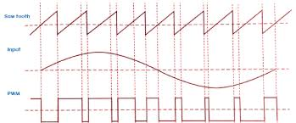
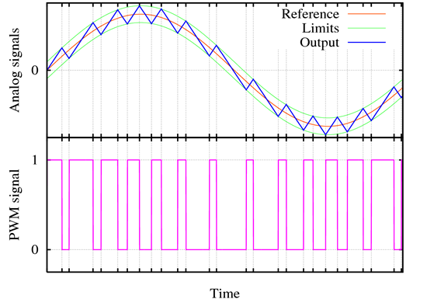

Slide 21
Pulse Width Demodulation:

Slide 22
Advantages:
PWM technology keeps LEDs from overheating while preserving their brightness.
PWM technology responds quickly and with accuracy.
A high input power factor is provided by the PWM technique.
Motors may provide their full torque even at lower speeds thanks to the PWM technology
Disadvantages:
The significant switching losses are a result of the high PWM frequency.
Radio Frequency Interference is caused by it (RFI).

Slide 23
Applications of PWM:
Modulation in electronics refers to the application of a regulating or shifting force on an object. Similar to the human voice, we also refer to it as a variation in the pitch, intensity, or tone of a frequency.
We frequently witness the usage of modulation techniques to operate devices such as LEDs or DC motors.
Maximum power point tracking (MPPT) in conjunction with PWM is a crucial technique for reducing a solar panel's output in order to align it with a battery's use.
By adjusting the duty cycle, an LED's brightness can be somewhat controlled. By diluting each of the three hues with varying amounts, an RGB (red, green, and blue) LED allows you to regulate the quantity of each color you require in the blend of variety.
The PWM process regulates the fan within the PC's CPU, which effectively disperses heat.

Slide 24
Pulse Position Modulation (PPM):

Slide 26
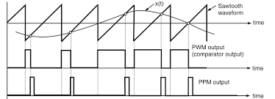

Slide 27
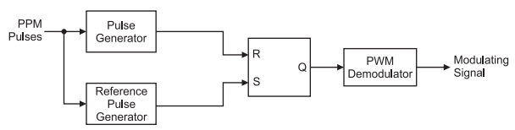
Pulse Position Demodulation:
The noise corrupted PPM waveform is received by the PPM demodulator circuit.
The pulse generator develops a pulsed waveform at its output of fixed duration and applies these pulses to the reset pin (R) of a SR flip-flop.
A fixed period reference pulse is generated from the incoming PPM waveform and the SR flip-flop is set by the reference pulses.
Due to the set and reset signals applied to the flip-flop, we get a PWM signal at its output.
The PWM signal can be demodulated using the PWM demodulator.

Slide 28
Advantages of Pulse Position Modulation:
These are some advantages of Pulse Position Modulation
Due to constant width of pulse , the transmission power remains constant and displays no variations.
PPM shows better noise immunity as compared to an amplitude modulated signal. This is because information in PPM is stored in position rather than amplitude.
The recovery process of PPM signal from its distorted form is easy and simple.
The PPM system has very low system requirements so it is frequently used in lightweight appliances with simple accessories.
The all-over power required for such system is low as compared to PAM making it a power-efficient modulation technique.

Slide 29
Disadvantages of Pulse Position Modulation:
These are some disadvantages of Pulse Position Modulation
The major limitation of this technique is that it requires large bandwidth as compared to other methods increasing the bandwidth consumption.
In order to perform detection of this signal at receiver, it is necessary that transmitter and receiver are synchronized. This is not possible every time.
It is really sensitive to phenomena like interference which can disturb a transmission by changing the difference in arrival times of every signal.

Slide 30
Applications of Pulse Position Modulation:
PPM is used in a variety of appliances and here are some of its applications.
This modulation technique finds its application in air traffic control systems, in radio control and in military applications.
Since PPM is used in non-coherent detection when we don't require a receiver having a PLL(Phase lock loop ) for tracking carrier phase.
Since this modulation technique helps in compression of data, it is often used for storage purpose.
We can employ PPM in optimal communication. This is done to minimize the dispersion effect and efficiently use the laser power.
PPM is employed in remote control systems, in which a stream of pulses is used to encode the information in bits.

Slide 31
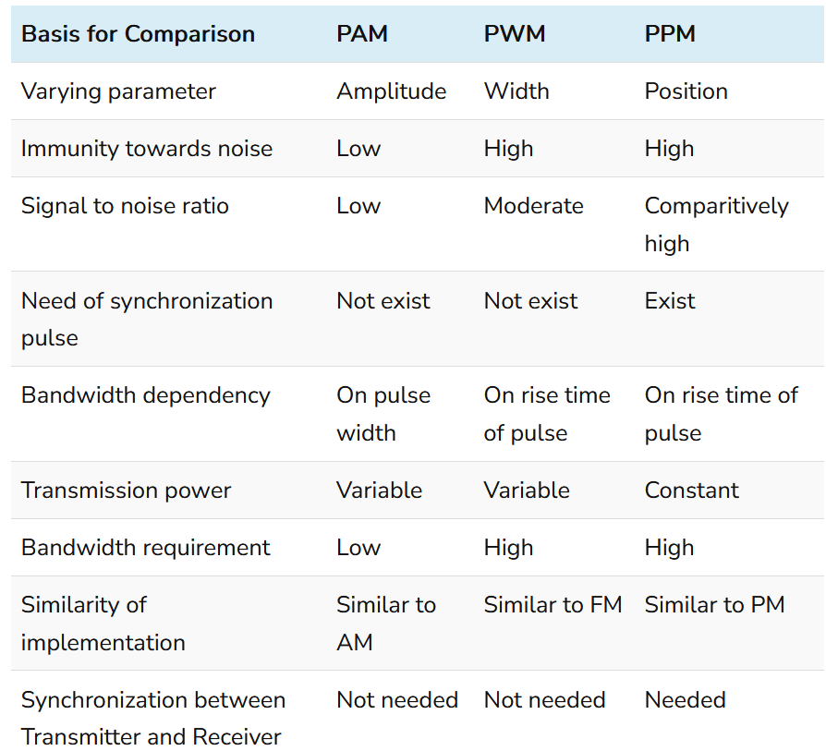

Slide 32
Pulse Digital Modulations

Slide 33
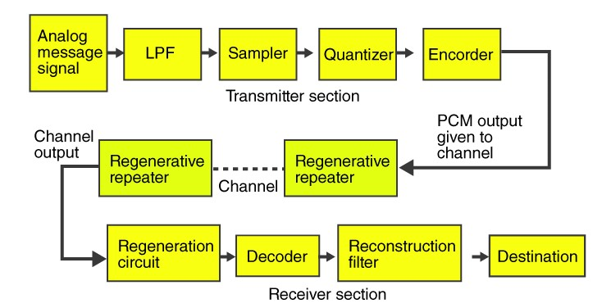
Pulse Code Modulation (PCM):

Slide 34
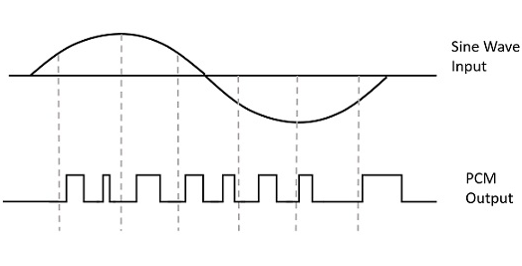

Slide 35
Low Pass Filter (LPF):
A low pass filter helps in removing the high-frequency components included in the input of the analog signal. These frequency components are higher than the highest frequency of the message signal. Hence, a low pass filter is added in the pulse code modulation technique to avoid aliasing of the message signal.

Slide 36
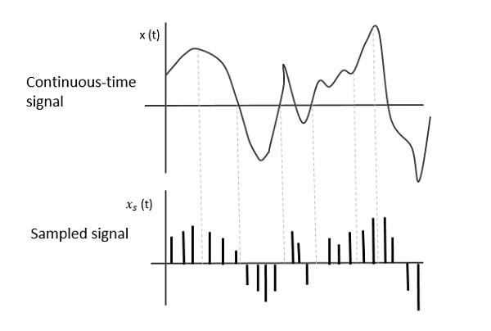
Sampler:
Sampler helps to collect the sample data at any time of the message signal, in order to reform the original signal. As per the sampling theorem, the sampling rate is greater than the highest frequency component of the message signal

Slide 37
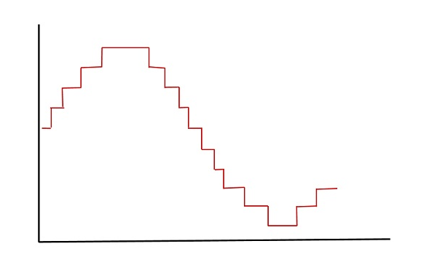
Quantizer:
Quantizer helps to minimise the error through the process known as quantizing. The sampled output when passed through a quantizer, reduces the unnecessary bits and also helps in compressing the obtained values.

Slide 38
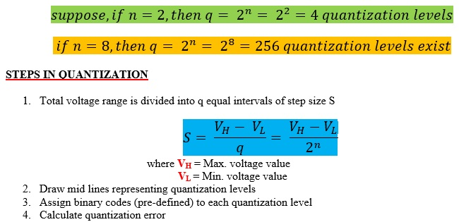

Slide 39
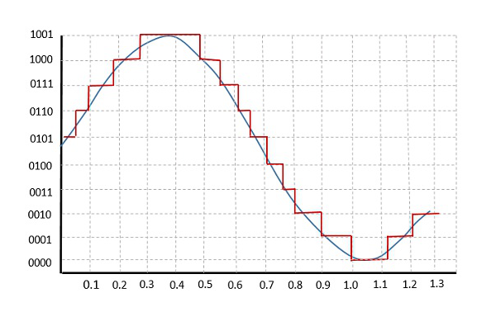
Encoder:
The encoder is used for digitising the analog signal. Encoder helps to allot each quantised level through a binary code. The sample-and-hold process is adopted in this. Low pass filter, sampler, and quantiser aids to convert analog to digital forms. Encoding also aids in minimising the usage of bandwidth.

Slide 40
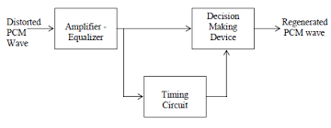
Regenerative Repeater:
Regenerative repeater is used to compensate for the signal loss and also reform the signal. It also helps to increase signal strength. Hence, the output of the channel is equipped with one regenerative repeater circuit.

Slide 41
Decoder:
The decoder helps to form the original signal by decoding the pulse coded waveform. Decoder acts as the demodulator.
Reconstruction Filter:
The reconstruction filter helps to obtain the original signal. In the pulse code modulator circuit, the given analog signal is digitized, coded and sampled. The resultant signal is transmitted in an analog form. In order to obtain the original signal, the whole process is repeated in a reverse pattern .

Slide 44
Advantages and Disadvantages
Advantages
Pulse Code Modulation is used in long-distance communication.
The efficiency of the transmitter in PCM is high.
Higher noise immunity is seen.
Efficient method.
Disadvantages
The bandwidth requirement is high.
PCM is a complex process, since it involves encoding, decoding and quantization of the circuit.
Applications of Pulse Code Modulation
It is used in telephony and compact discs.
Pulse Code Modulation is used in satellite transmission systems and space communications.

Slide 45
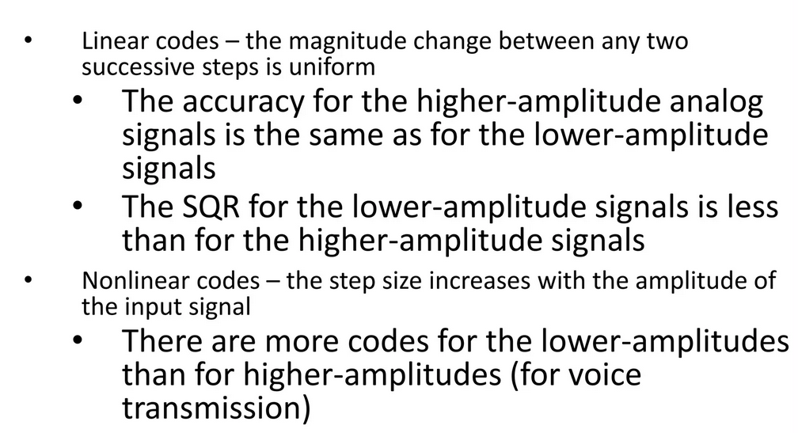
Linear PCM Vs Non-linear PCM:

Slide 46
Sampling Process:
A continuous time signal can be represented in its samples and can be recovered back when sampling frequency f_{s} is greater than or equal to the twice the highest frequency component of message signal. i. e.
fs≥2fm
Consider a continuous time signal x(t). The spectrum of x(t) is a band limited to f_{m} Hz i.e. the spectrum of x(t) is zero for |ω|>ω_{m}.
Sampling of input signal x(t) can be obtained by multiplying x(t) with an impulse train δ(t) of period T_{s}. The output of multiplier is a discrete signal called sampled signal which is represented with y(t) in the following diagrams:

Slide 47
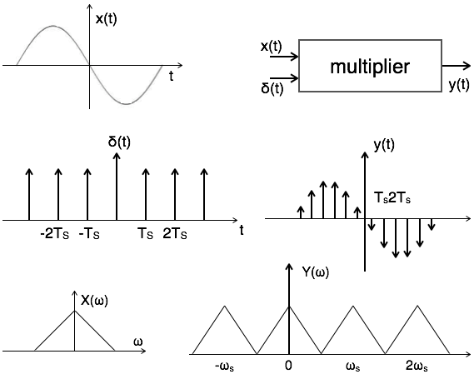

Slide 48
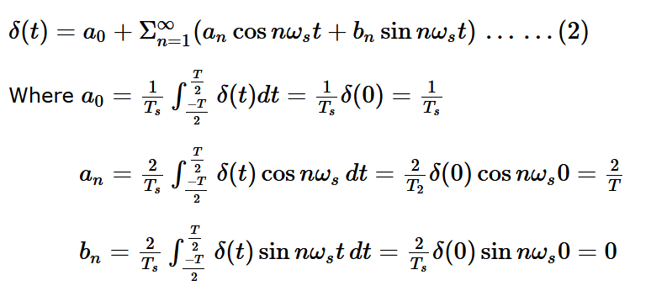
Here, you can observe that the sampled signal takes the period of impulse. The process of sampling can be explained by the following mathematical expression:
Sampled signal y(t)=x(t).δ(t)......(1)
The trigonometric Fourier series representation of δ(t) is given by

Slide 49
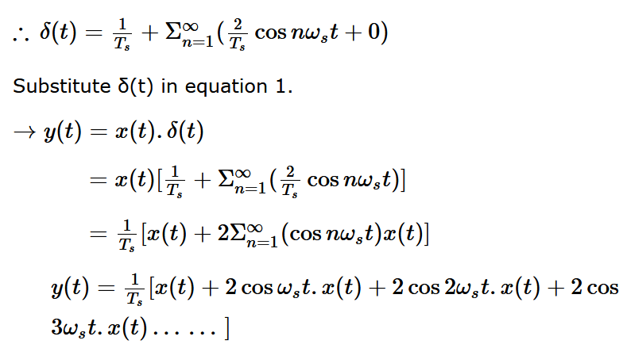
Substitute above values in equation 2.

Slide 50
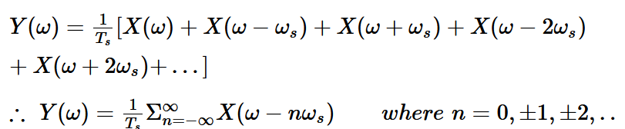
Take Fourier transform on both sides
To reconstruct x(t), you must recover input signal spectrum X(ω) from sampled signal spectrum Y(ω), which is possible when there is no overlapping between the cycles of Y(ω).

Slide 51
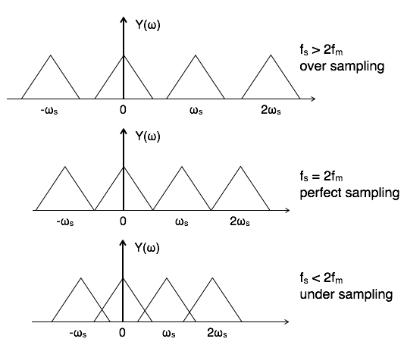
Possibility of sampled frequency spectrum with different conditions is given by the following diagrams:

Slide 52
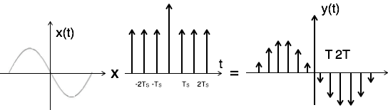
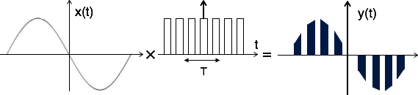
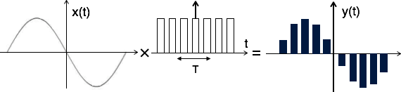
There are three types of sampling techniques:
Impulse sampling.
Natural sampling.
Flat Top sampling.

Slide 53
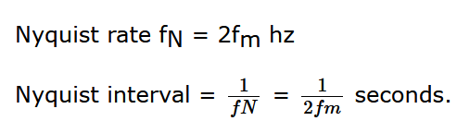
Nyquist Rate/sampling rate:
It is the minimum sampling rate at which signal can be converted into samples and can be recovered back without distortion.
In case of band pass signals, the spectrum of band pass signal X[ω] = 0 for the frequencies outside the range f₁ ≤ f ≤ f₂. The frequency f₁ is always greater than zero.

Slide 54
Quantization:
The method of sampling chooses a few points on the analog signal and then these points are joined to round off the value to a near stabilized value. Such a process is called as Quantization.
Quantization is representing the sampled values of the amplitude by a finite set of levels, which means converting a continuous-amplitude sample into a discrete-time signal.
Both sampling and quantization result in the loss of information. The quality of a Quantizer output depends upon the number of quantization levels used. The discrete amplitudes of the quantized output are called as representation levels or reconstruction levels. The spacing between the two adjacent representation levels is called a quantum or step-size.

Slide 56
Types of Quantization:
There are two types of Quantization - Uniform Quantization and Non-uniform Quantization.
The type of quantization in which the quantization levels are uniformly spaced is termed as a Uniform Quantization. The type of quantization in which the quantization levels are unequal and mostly the relation between them is logarithmic, is termed as a Non-uniform Quantization.

Slide 57
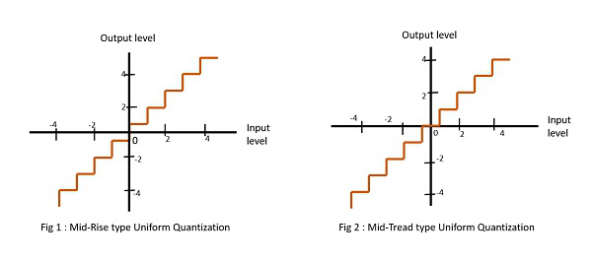
There are two types of uniform quantization. They are Mid-Rise type (The quantization levels in this type are even in number) and Mid-Tread type (The quantization levels in this type are odd in number). The following figures represent the two types of uniform quantization.

Slide 58
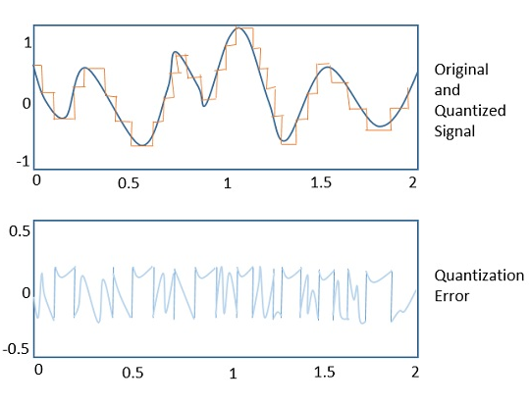
Quantization Error:
The difference between an input value and its quantized value is called a Quantization Error. A Quantizer is a logarithmic function that performs Quantization Rounding off the Value.

Slide 59
Quantization Noise
It is a type of quantization error, which usually occurs in analog audio signal, while quantizing it to digital. For example, in music, the signals keep changing continuously, where a regularity is not found in errors. Such errors create a wideband noise called as Quantization Noise.

Slide 60
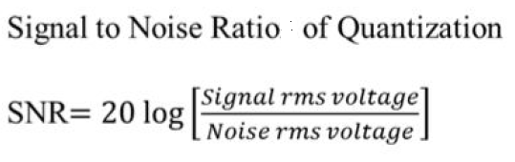
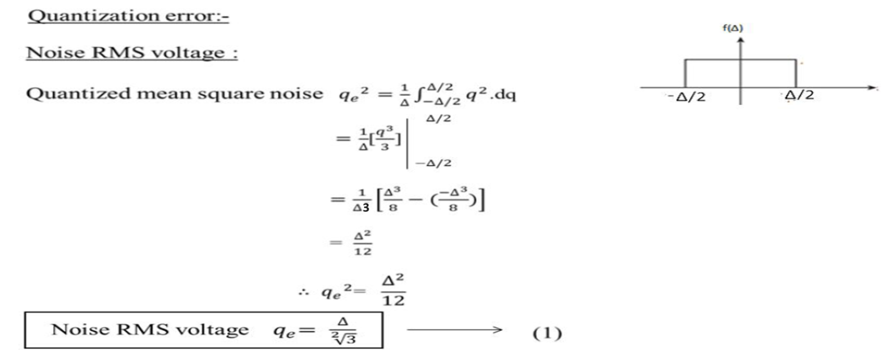
Signal to Noise Ratio in PCM:

Slide 62
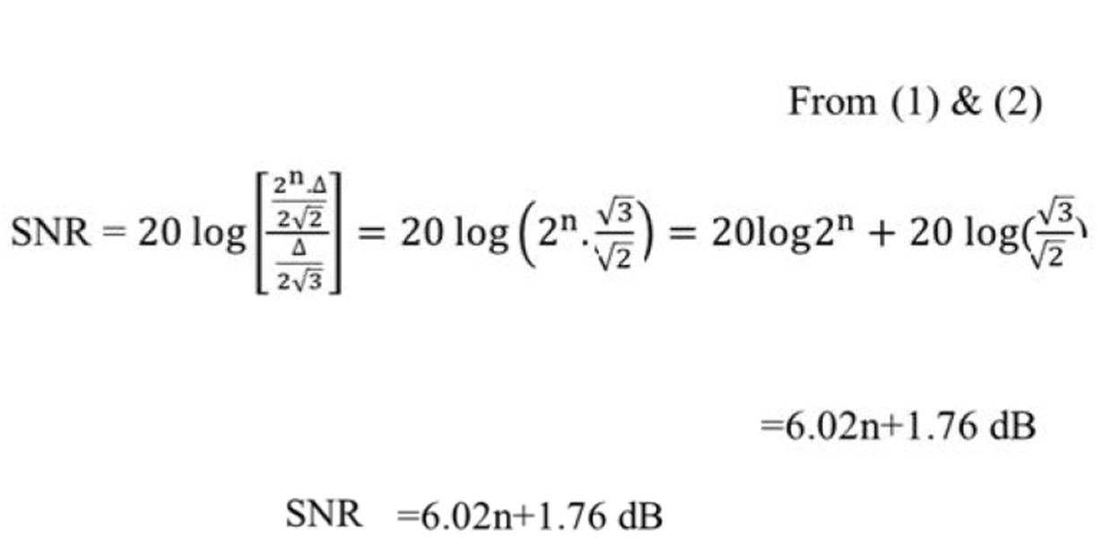

Slide 63
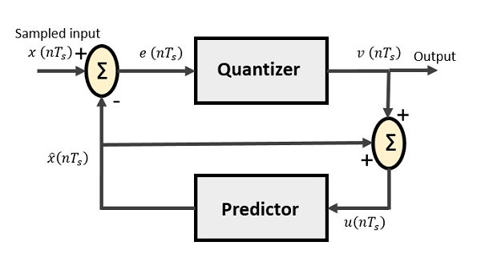
Differential PCM:
Modulator Diagram

Slide 64
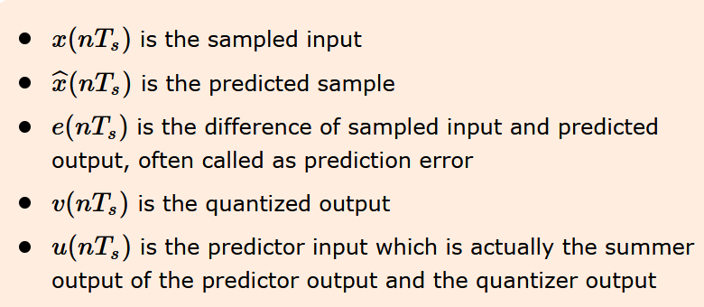
The predictor produces the assumed samples from the previous outputs of the transmitter circuit.
The input to this predictor is the quantized versions of the input signal x(nTs).

Slide 65
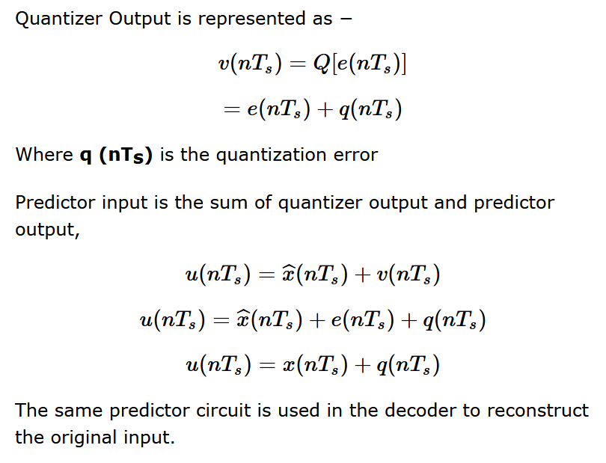

Slide 66
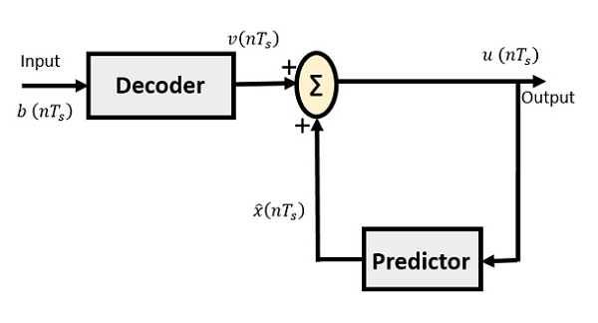
Demodulator Diagram

Slide 68
Delta Modulation (DM):
The sampling rate of a signal should be higher than the Nyquist rate, to achieve better sampling. If this sampling interval in Differential PCM is reduced considerably, the sample to-sample amplitude difference is very small, as if the difference is 1-bit quantization, then the step-size will be very small i.e., Δ delta.
Delta Modulation is a simplified form of DPCM technique, also viewed as 1-bit DPCM scheme. As the sampling interval is reduced, the signal correlation will be higher.

Slide 69
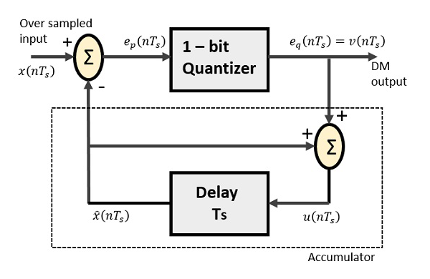
Modulator Diagram

Slide 71
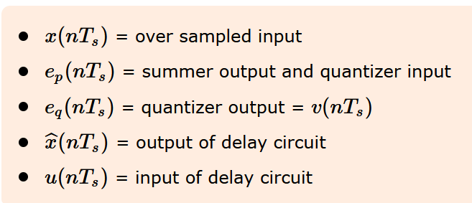
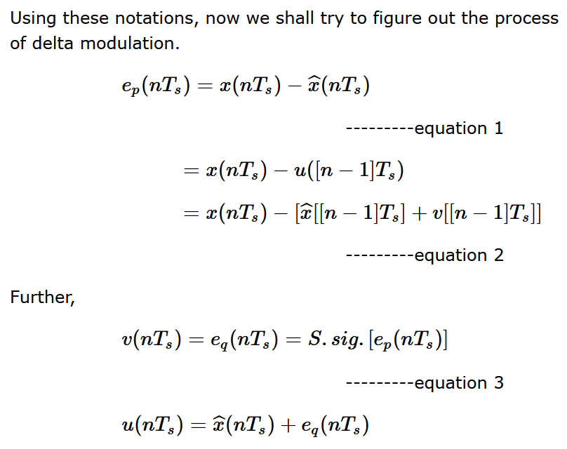

Slide 72
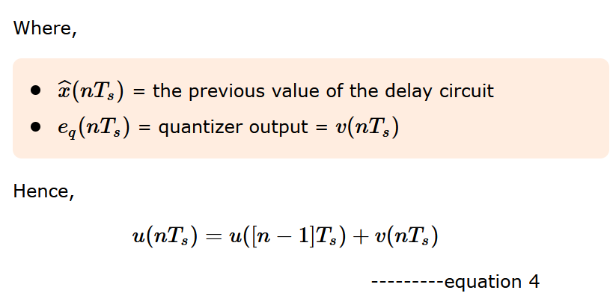
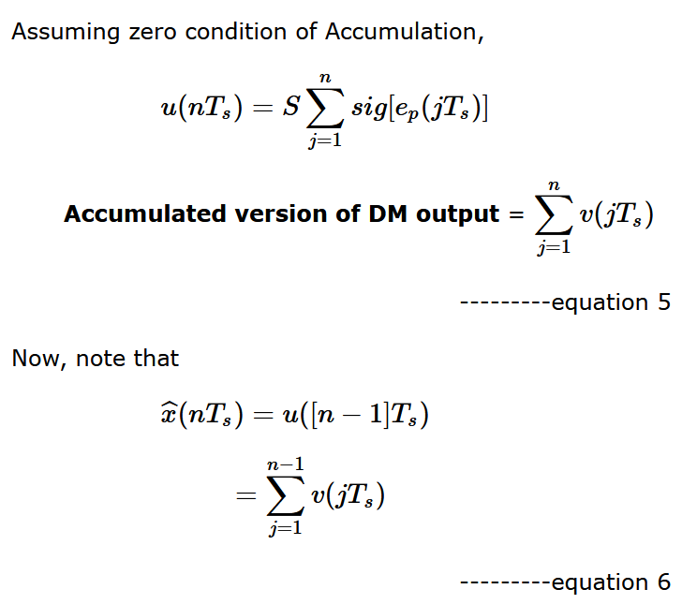

Slide 73
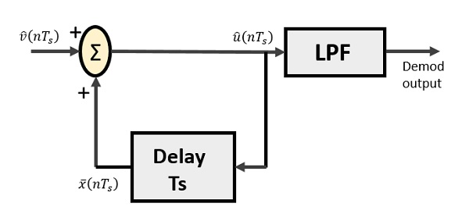
Demodulator Diagram

Slide 74
Drawbacks of DM:

Slide 77
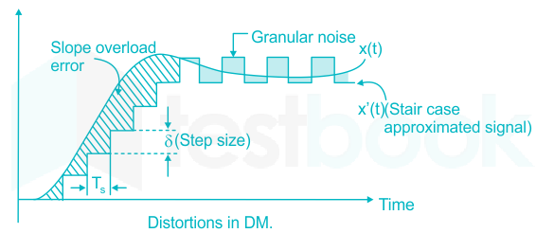
Granular Error:

Slide 80
Signalling rate=n*fs
=1*fs=fs bits/sec
Bandwidth= n*fm
=1*fm=fm hertz

Slide 81
Adaptive Delta Modulation (ADM):
In digital modulation, we have come across certain problem of determining the step-size, which influences the quality of the output wave.
A larger step-size is needed in the steep slope of modulating signal and a smaller stepsize is needed where the message has a small slope. The minute details get missed in the process. So, it would be better if we can control the adjustment of step-size, according to our requirement in order to obtain the sampling in a desired fashion. This is the concept of Adaptive Delta Modulation.

Slide 83
The gain of the voltage controlled amplifier is adjusted by the output signal from the sampler. The amplifier gain determines the step-size and both are proportional.
ADM quantizes the difference between the value of the current sample and the predicted value of the next sample. It uses a variable step height to predict the next values, for the faithful reproduction of the fast varying values.

Slide 85
PCM Companding:
Companding, or Companded Pulse Code Modulation, is a technique used in Pulse Code Modulation (PCM) to compress and expand signals to improve the signal-to-noise ratio (SNR)
Compression
The signal is compressed at the transmitter end. For example, in a PCM transmitter, diodes are inserted in the analog path to compress the dynamic range of the analog signal.
Expansion
The signal is expanded at the receiver end. For example, in a PCM receiver, diodes are placed after the low pass filter to expand the signal back to its original dynamic range.

Slide 86
A-law Companding Technique
Uniform quantization is achieved at A = 1, where the characteristic curve is linear and there is no compression.
A-law has mid-rise at the origin. Hence, it contains a non-zero value.
A-law companding is used for PCM telephone systems.
A-law is used in many parts of the world.
µ-law Companding Technique
Uniform quantization is achieved at µ = 0, where the characteristic curve is linear and there is no compression.
µ-law has mid-tread at the origin. Hence, it contains a zero value.
µ-law companding is used for speech and music signals.
µ-law is used in North America and Japan.

Slide 87
